Slide 1
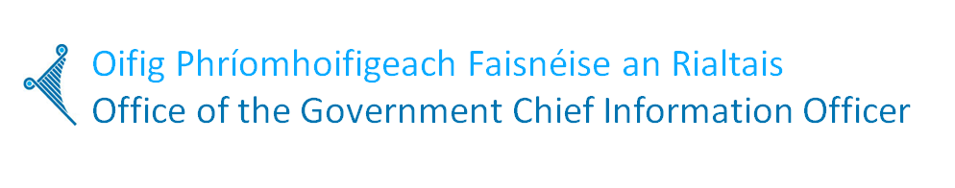
ICT Strategy Planning Session
Public Service CIO Council Workshop
Wednesday 11 September 2013

Slide 2
Aims for Today
First step in co-creation of an ICT Strategy
An ICT Strategy that:
Creates space for CIOs to progress & succeed
Is based on shared functions & collaboration
Demonstrates progress through metrics
Maximizes benefits to both the organisation & citizens/businesses
Is designed for the future not the past
Addresses the ICT capability gap

Slide 3
Key Themes
Invest to Transform
Need to release resources to support Reform Agenda
Rebalances investment - move from 90/10 towards 60/40
More effective utilisation of resources over time
Develops a more mature approach to outcomes based actions
Manage transition through metrics
Build to Share
Building and delivering common platforms
Cloud, Network, Cyber, Info Management, Identity ….
Co-created by Government, Industry & Academia
Creates new competencies/capabilities (90/10 results in KTLO competencies)
Design for Digital
Automated provisioning & self service
Encompasses new era of ‘digital’
More effective in meeting citizen/business needs

Slide 4
Outputs from Today
Agreed themes
Some high level actions
Some measureable outputs/outcomes
A framework to develop a first draft ICT Strategy

Slide 5

The poorest performing IT organizations are distinguished by weak delivery practices
The highest performing IT organizations are distinguished by strong strategy practices
Notes:
The bottom quartile of IT organizations can be differentiated by their inability to deliver services reliably. (Inability to do things right.)
But for leading IT organizations, delivery is ‘necessary but not sufficient’ to excel. For the top IT organizations, ensuring IT is focused on business success is the key differentiator. (Ability to do the right things.)
IT strategy is a tough nut to crack. but great IT strategies change the value potential of the IT organization, and the perceptions of IT held by the rest of the business.

Slide 6
Great IT Strategies Are Brief, Complete, Business-Success-Focused
How will we win, and how will IT help?
How will we ensure strategic decisions and behaviors?
How will we evolve IT supply and capability?
Demand
Control
Supply
Business Context
IT Principles
IT Services
Business Success
Business Success
IT Governance
Architecture
Bus. Capabilities
IT Fin. Mgmt.
People
IT Contribution
Metrics
Sourcing
Notes:
Enterprises differ as to their strategies, but any great IT strategy has a few key characteristics: It is brief,
complete and focused on business success. Our research suggests that the main body of an IT strategy
should be no more than 20 pages. If it is any longer, no one will read it. To achieve the level of clarity
required, create a concise, well-structured document.
The Gartner IT strategy template (see figure opposite) covers 12 topics in three main sections:
• The demand section outlines how the business will win, and how IT will contribute.
• The control section discusses how management control will be exercised.
• The supply section outlines how IT will deliver the contribution.
In addition, there is an executive summary and a risks and issues section summarizing the top risks the
strategy incurs (and how to handle them) — plus any detailed appendices that may be required.

Slide 7
Clarify the scope and purpose of your IT strategy
 |  | Questions | Examples
WHO | Who is this strategy primarily for? |  | Board, CEO, Group IT
 | Who are other key stakeholders? |  | Board, BU CEOs, BU CIOs, Group IT
 | What roles will they play? |  | Sponsor, ratify, create, review
WHY | What exactly do we want to achieve with this strategy? |  | Ensure IT is adding as much value as possible, build IT’s credibility, inspiring the IT organization, avoiding deviance from direction
 | Any specific burning issues to solve? |  | Making group vs. business unit approaches visible
 | How will we know if it’s successful? |  | Architectural compliance, IT staff will know strategy
WHAT | What entities will this cover? |  | Whole group, corporate only, some geographies only, some business units only
 | What areas will this cover? |  | IT, information, Operational Technologies (OT), other non-IT such as business process change
 | Any conventional areas to exclude? |  | (Refer to the strategy template in this document)
 | What timeframes? |  | Detailed plan for 12-18m, direction for 3-5 years
HOW | Touch points with other processes? |  | With business strategy, budget cycle
 | How much of who’s time to create it? |  | 2 months effort for strategist and architect + 1 consultant
 | Where will external input be used? |  | Reviews of template, process and final draft
 | How long will it take? |  | 6 months
Notes:
Like any activity, strategy creation must have a clear purpose. Also, because IT is not the same in every business, the scope of the strategy should be outlined for your enterprise. The tool on page 10 identifies a series of purpose and scope questions to answer before embarking on a strategy creation or refresh exercise. The questions break down into four categories:
• Who. Identify the primary target of the strategy, the other key stakeholders and their roles. IT strategies are commonly targeted at the business leadership and the IT organization, with IT taking responsibility for the bulk of their creation, using input from senior business stakeholders and potentially retaining consultants to perform particular analyses.
• Why. Highlight the purpose of the strategy. Is it to surface assumptions that promote agreement, ensure that the IT organization is going in the right direction, build IT’s credibility with the rest of the business, inspire the IT organization, etc.
• What. Identify what this strategy will cover in terms of time periods, functional areas, business units and enterprises. Most current IT strategies include data and voice communications. Some include information management; some don’t. Some include non-IT services, such as libraries, knowledge management, business process improvement and enterprise risk management. There is no wrong answer here—except for being unclear as to what is in scope and what is outside it.
• How. determine how much of whose time will be used over what time period. How will the process dovetail with enterprisewide planning, budgeting, etc.? It is particularly important to think through the question of what time period your IT strategy will cover.

Slide 8
What is driving you?
Business Context
Disruptive innovation
Politics
External Drivers
Regulatory Changes
Socio-economic
CHALLENGE
OR
OPPORTUNITY?
Products & Services?
Internal Drivers
Growth/
Contraction
Costs
Complexity
Notes:
What is the business context?
What are the key elements of the business model? What are the primary products and services, how have these changed over the past year and how will they change over the next year?
What are the internal and external factors affecting business strategy? Is Innovation and growth a big factor? Is cost cutting a big factor? Are there new pressures in the industry which must be considered? Are there any regulatory or legislative issues? Are there changes in the industry value chain (i.e. among customers, suppliers, etc.)? Are there any disruptive technology innovations which will potentially impact the business?
Over the next 3 years, what are the major challenges that must be overcome, or opportunities that must be captured, in order for the organisation to be “successful”?
What is at the root of each challenge or opportunity? How is each challenge or opportunity different than what has faced in the past? How is each different than other players in the value chain?

Slide 9
Investing to Transform
Discussion points | Opportunity
Examine potential cost saving areas | Rationalisation - because it … Simplification - because it… Standardisation Sharing & Collaboration Reduced duplication Reduced waste …
Faster implementation & better responsiveness to citizen requests | Agile Procurement ….
Measurement | Metrics …
User Examples | What does success look like?
Move us towards 60/40
Moves us quicker to 60/40

Slide 10
Recognising the Value Propositions
Operational
Efficiency
Re-use and share resources
Citizen
Service
Reduce cost of change
Increase employee satisfaction
Integrate third-party channels
Cut cost of compliance
Minimize risk
Avoid re-work
NPV
Improve timeliness
Encourage participation
Payback period On time delivery On budget delivery …
Enhance organisation’s brand
Align with program’s mission
Political Return
Comply with new laws
Spur economic growth
Notes:
Key Issue: How Can IT Investments Deliver Public Value?
Many IT cost cutting decisions need to be taken in order to have an effect on this year's budget, but in most cases they must be corroborated by an analysis of how they may impact operational efficiency, constituent service and the ability to fulfill an agency's mission.
• Many government agencies need to determine where to cut IT costs but also need to appraise how cost cutting impacts the value IT creates.
• Public value impact analysis should be pursued whatever the maturity of the IT investment planning and management processes. However, the framework and method chosen to perform it should take the level of maturity into account.
• Public value impact analysis should be applied only to the most viable and not to all cost-cutting alternatives. The analysis should occur on a continuous basis to actively manage a portfolio of initiatives.
Recommendations
• Government CIOs must make value impact analysis an integral part of their costcontainment strategies, because this will help position them better to defend decisions downstream.
• Government CIOs must rely on value frameworks that are already used by their organizations, but they should also be prepared to simplify and take shortcuts to fit the time constraints of their cost-cutting decisions. If no framework is currently in use, they must choose a simple one that works for their circumstances, because good-enough value impact analysis is better than none.
• Government CIOs need to select value metrics that can be used for both business-unit specific and enterprisewide cost-cutting measures.

Slide 11
Exploitation of New Technology & Demand for Automation
Discussion points | Opportunity
User Outcomes | Increased automation/self-service Improved user experience Reduced burden of participation Designed for needs of user Delivery Platforms Delivery Channels Mobile infrastructure …
Measurement | Higher levels of take-up & completion Open Services
User Examples | What does success look like?

Slide 12
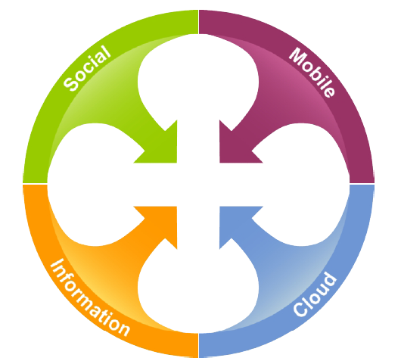
What’s driving IT and digital strategies?
The Convergence of Four Forces is transforming user behaviour and user expectations, creating new business opportunities. Known as the “Nexus of Forces” – it is the convergence and mutual reinforcement of social, mobility, cloud and information patterns that drive new business scenarios.

Slide 13
Focus on the Citizen
Opportunity | Mechanism
Better User Experience | User-centric Digital Delivery Automation Data Sharing (provide info once to Government) Openness & Transparency …
Efficient Government Procedures | PSC Infrastructure Geo-Spatial Records Management Standardised Data Model Infrastructure/Cloud Procurement Data Privacy
User Examples | What does success look like?

Slide 14
A refreshed and co-ordinated ICT Strategy – a launch-pad to ‘Invest to Transform’?
‘Digital’ has changed the way we live, work & play
What services, which departments/organisations?
Where might we start?
How do we sell it?
Who are the key stakeholders?
What else should we be thinking about?
10 minutes, groups of 3 then a 5 minute plenary

Slide 15

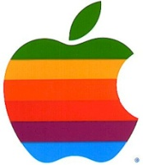

Why Will You Succeed?
Business Success
Customer Intimacy
Product Leadership
Operational Excellence
Notes:
Strategy defines the enterprise's posture: "How we will win." It must be about overall direction to drive business success, and specific enough to drive trade-offs. The strategy must not consist of generic statements such as, "We will delight customers" or "We will strive to be efficient." Examples of trade-offs include designing processes for flexibility versus efficiency, and using price as a signal of quality versus undercutting your competitor. The figure shows a useful way of expressing trade-offs that can helpful in formulating the business and IT strategy. The value disciplines (created by Treacy and Wiersema) are based on the fact that the most successful enterprises chose a discipline in which to excel, while choosing to be just good enough in others. For example, Wal-Mart seems to have chosen operational excellence as its value discipline, which led it to invest so early and so strongly in RFID. You can use this approach to distinguish between "commodity" processes and differentiators, leading you to drive out complexity and diversity in commodity processes, but allow richness and flexibility in differentiator processes.
CIOs are often challenged to connect strategic posture to IT strategy, because it is high-level and focused on outcomes. Some enterprises have become more thoughtful about using business capabilities to bridge the gap between outward-facing strategic posture and internal plans. For others that succeed in supporting their strategy with internal activities, retrospective analysis suggests they did so by focusing on the right capabilities. Note that this approach applies to both public- and private-sector enterprises. Public-sector enterprises also have scarce resources and so must focus on them in order to sustain success.

Slide 16
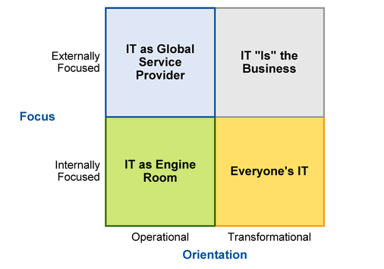
The Four Futures of IT

Slide 17
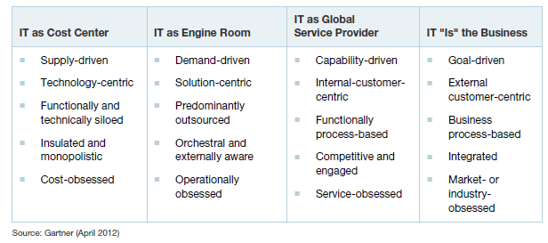
IT’s Evolving Role in the Business
Notes:
This compares “at a glance” the role, purpose and advantages of the first three role paradigms in relation to the traditional IT cost centre.

Slide 18
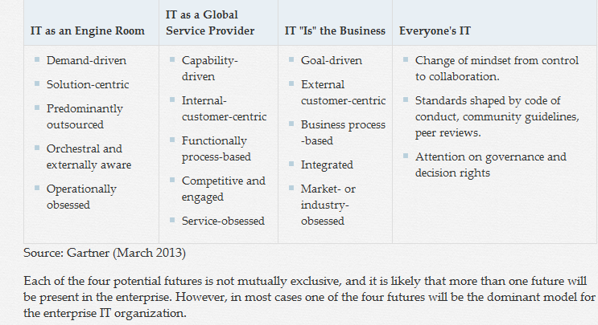
IT’s Evolving Role in the Business
Notes:
This compares “at a glance” the role, purpose and advantages of the first three role paradigms in relation to the traditional IT cost centre.

Slide 19
How might this apply to us?
Discuss where each of the different departments are currently operating
What is your KTLO/Transform split?
What are you key themes for next 2 years
Is this right? Where could you be?
Where could you collaborate/share?
How do you get there?
10 minutes, groups of 3 then a 5 minute plenary

Slide 20







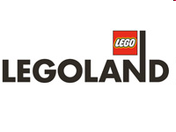







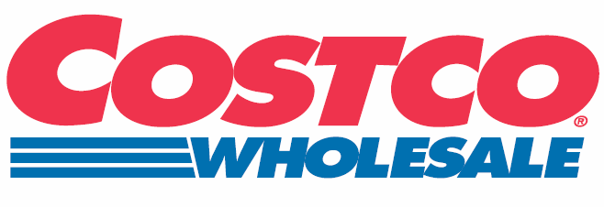
The Discipline of Market Leaders
Product
Leadership
Best
Product
High Touch and Best Product
Best Product
at Best
Time/Cost
Middle Ground
Best
High Touch
Best Time/Cost
Customer
Intimacy
Operational
Efficiency
Best Time/Cost
Plus High Touch
Source: Michael Treacy and Fred Wiersema, "The Discipline of Market Leaders," 1995
Notes:
Decision Framework: Because no enterprise in pursuit of market leadership can excel simultaneously in product superiority, operational efficiency and customer intimacy (unless it has unlimited resources), there are trade-offs to be made.
In "The Discipline of Market Leaders" by Treacy and Wiersema, it was asserted that enterprises that emerge as market leaders excel in at least one of the following three areas, and are as good as the competition in each of the others: 1) Operational excellence, meaning that their back office, operational systems and processes are so good that they have a cost advantage; 2) Product leadership, meaning that they drive the market on the strength of their products, giving them a unique product or service offering; or 3) Customer intimacy, meaning that they are so close to the customer and establish such a strong relationship that the customer has no desire to buy elsewhere. All enterprises tend to pursue some combination of these traits; none can master all three disciplines unless they have unlimited resources.
When applying this to CEM, many assume that it is synonymous with the customer intimacy discipline. It is not. It is possible to have a viable approach to improving the customer experience when pursuing all three of the above disciplines, as illustrated by the examples above.
Action Item: Enterprises should provide a superior customer experience regardless of whether they aim to become a market leader by excelling at product superiority, operational efficiency or customer intimacy.

Slide 21

What do you need to get you there?
Bus. Capabilities
Supporting Reform by Building Capabilities
Strategic:
Make a material difference to efficiency and productivity
Keep delivering throughout many years
Supports the transformation agenda
Business:
Recognized and developed directly by business leaders
Seldom under control of the CIO
Not "technologies" — but most require or exploit them
Capabilities:
Competencies or management disciplines
Require process, organization and culture development
Built, not bought (exception: by business acquisition)

Slide 22
Capabilities are the glue that connects demand-side strategy and supply-side plans
Outside-in perspective: strategic posture
Customer Intimacy
Product Leadership
Operational Excellence
Supports and drives
Requires
Cycle time
M&A
Efficiency
Collaboration
Innovation
Process improvement
Agility
Transparency
Change
Inside-out perspective: business capabilities
Notes:
CIOs are often challenged to connect IT strategy to business strategy because the business strategy is high-level, more focused on outcomes and a market-facing strategic posture.Some enterprises have become more thoughtful about using business capabilities to bridge the gap between outward-facing strategic posture and internal plans. for others who succeed in supporting their strategy with internal activities, retrospective analysis suggests they did so by focusing on the right capabilities.
Owner of the global franchise, 7-Eleven Japan is a great example of a capability-based model. Most would envisage the convenience store business as an “operational excellence” play, since products are rarely highly differentiated and customers do not have long, service-based relationships with the brand. 7-Eleven’s vision of “solving customers’ everyday problems” (attributed to CEO Toshifumi Suzuki) reveals a customer-intimacy focus. 7-Eleven invests heavily in three capabilities to support this: business intelligence to understand customer needs, an agile supply chain to deliver what customers need, and tools for store managers to use in rapidly adapting their store. The outcome: stores that can change what is on the shelves several times per day. The value: 7-Eleven Japan’s revenues and profits have grown consistently for 30 years.
Examples of business capabilities include: product innovation to create superior products, the ability to execute mergers, a high-performance workplace that attracts the best candidates, a culture of continuous improvement, a high level of internal transparency, the ability to improve processes, a highly responsive supply chain, ability to collaborate across business areas and the ability to execute change at high speed.
Capabilities are most useful when they are extremely specific. Terms like agility, collaboration and innovation alone are insufficient. Low-latency supply chain, knowledge-based collaboration across business units, and product innovation are better. Focusing on business capabilities is particularly important when there is great uncertainty or transformational change, or a very unclear business strategy.
Tactical Guideline: All companies must focus to win; work with your colleagues to determine how your company competes.

Slide 23
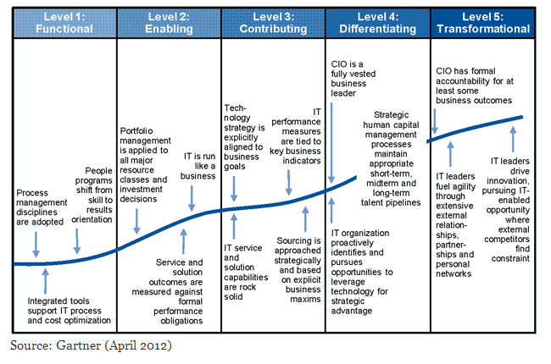
Gartner’s IT Maturity Model

Slide 24
How does IT contribute to Public Service success?
IT Contribution
IT’s Contribution to Reform
Systems:
Collaborative/social media/inclusive
Robust/secure/transactional
Scalable/agile/adaptable
Behaviours:
Business engagement focus
Professionally aligned
Reliable and predictable outcomes
Competencies:
Innovative thinking
Technical rigour
Financial discipline
Architectural alignment
Governance and prioritisation

Slide 25
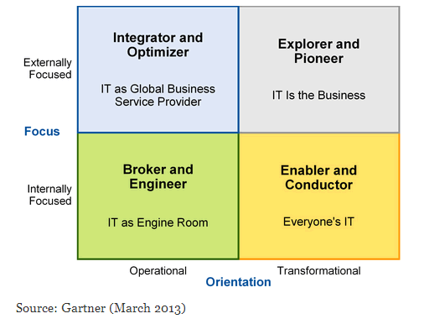
The Four Futures of The CIO Role

Slide 26
Where do we need to focus our energy to meet the challenge?
“What should our ambition be for Ireland?”
Plenary to discuss:
How do we now lead that within our teams?
What needs to be recognised as ‘good’ behaviours, values, approaches, ways of working?
What does the ‘Centre’ need to do to support?
What doesn’t work anymore?

Slide 27
Next Steps and Actions
Agree next steps
What themes have we identified?
What actions are needed
Next workshop

